Slide 1
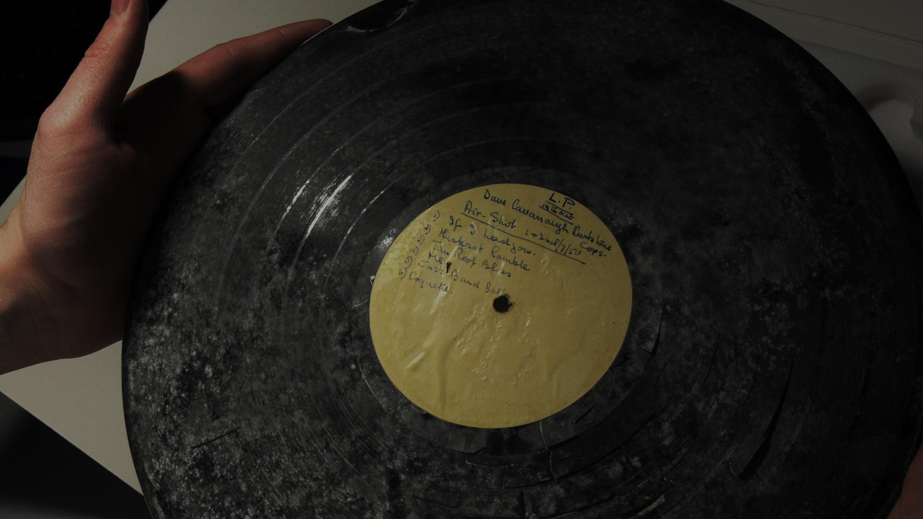


Audio Preservation and Access:
Overcoming the Challenges
Adam Tovell, Head of Technical Services, Sound & Vision, The British Library
British and Irish Sound Archives Conference, Aberystwyth, 2018

Slide 2
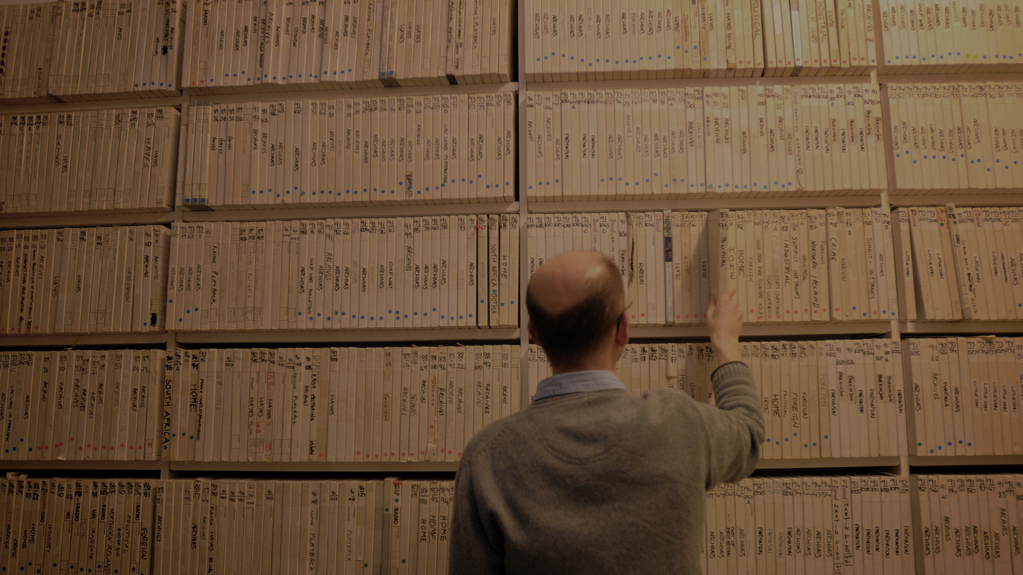


Not Just Books: Sound at the British Library
The British Library is home to the nation’s Sound Archive
Over 1.5 million physical items
6.5 million recordings of speech, music, wildlife and the environment, dating from the 1880s to the present day
75% published; 25% unpublished
More than 40 different formats

Slide 3
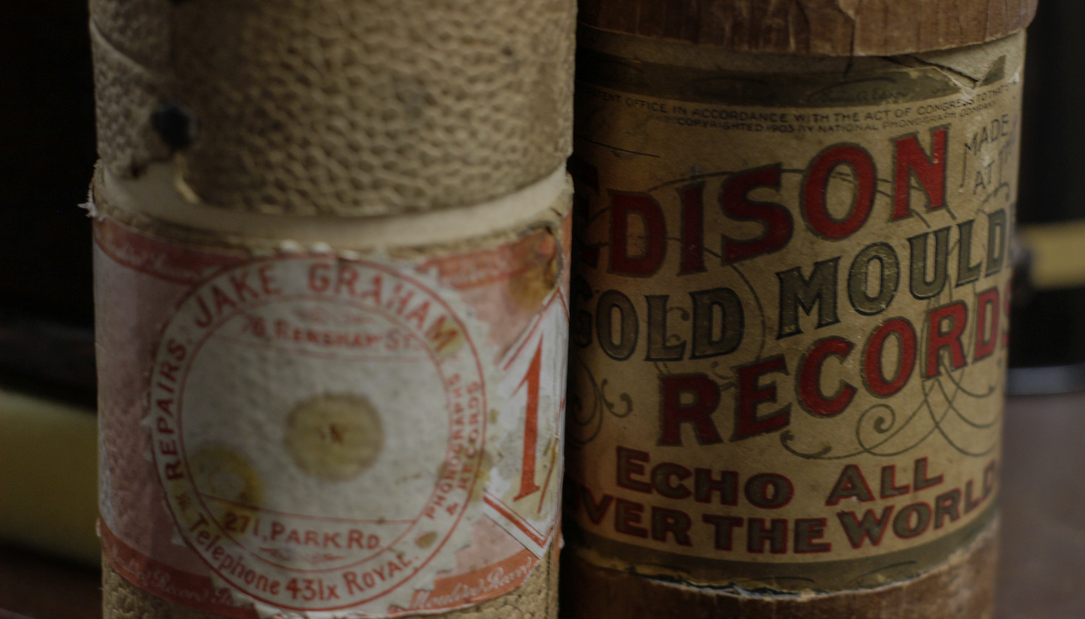
Save our Sounds
Consensus that we have between 10 and 20 years to preserve our collections
In 2015, the Library created its Save our Sounds Programme
An 8-year programme to preserve our existing collection and enable the preservation of future collections

Slide 4
Unlocking our Sound Heritage
In 2017, the Library received a grant from the Heritage Lottery Fund to fund “Unlocking our Sound Heritage”
A 5-year project to digitally preserve 110,000 items from the Library’s unpublished collections and 50,000 from 10 partner institutions around the UK
Make 470,000 recordings from those items available to listeners.

Slide 5
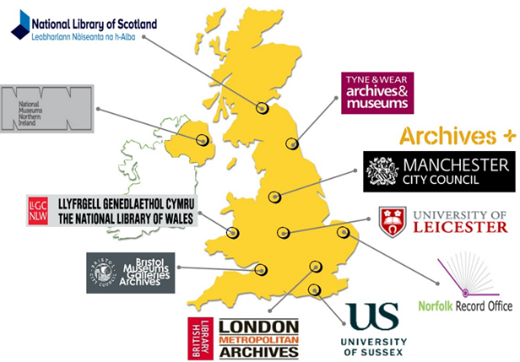

Slide 6
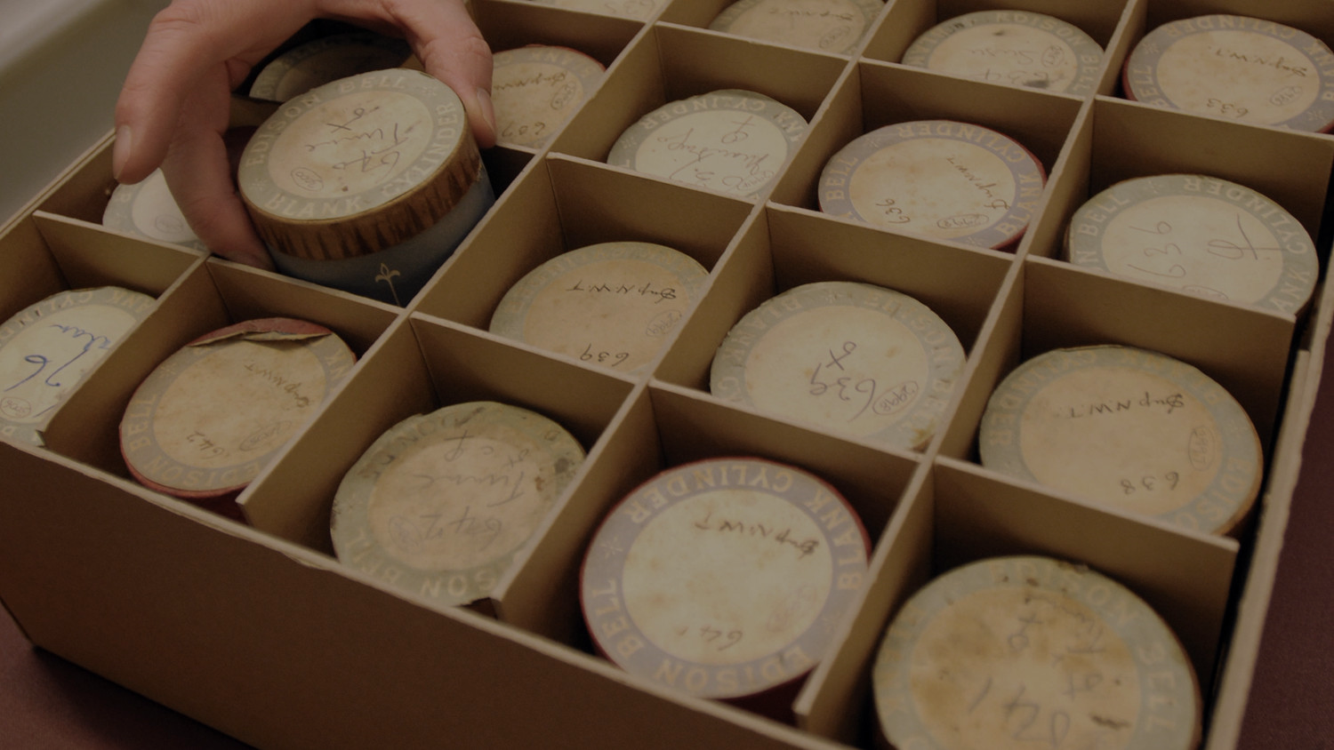
The Challenge
Large-scale preservation and access for multiple institutions requires an end-to-end system which is as integrated as possible
Preservation and access are often treated as separate activities, supported by systems developed in silos
An end-to-end system is needed which enables multiple-user preservation of information packages with preservation-level metadata
Enable access meeting the needs of researchers and the interested public without additional manual steps

Slide 7
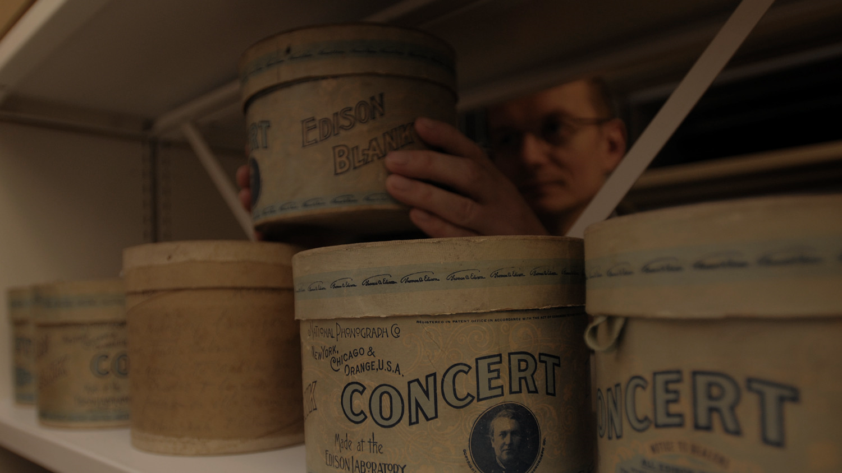
A Solution: Metadata
Data modelling exercise: how do physical items, audio files, descriptive records and recordings relate to one another?
A METS profile for audio
New schemas for preservation metadata
A tool to create information packages with full METS records
IIIF for AV: a new metadata framework for delivering audio online

Slide 8
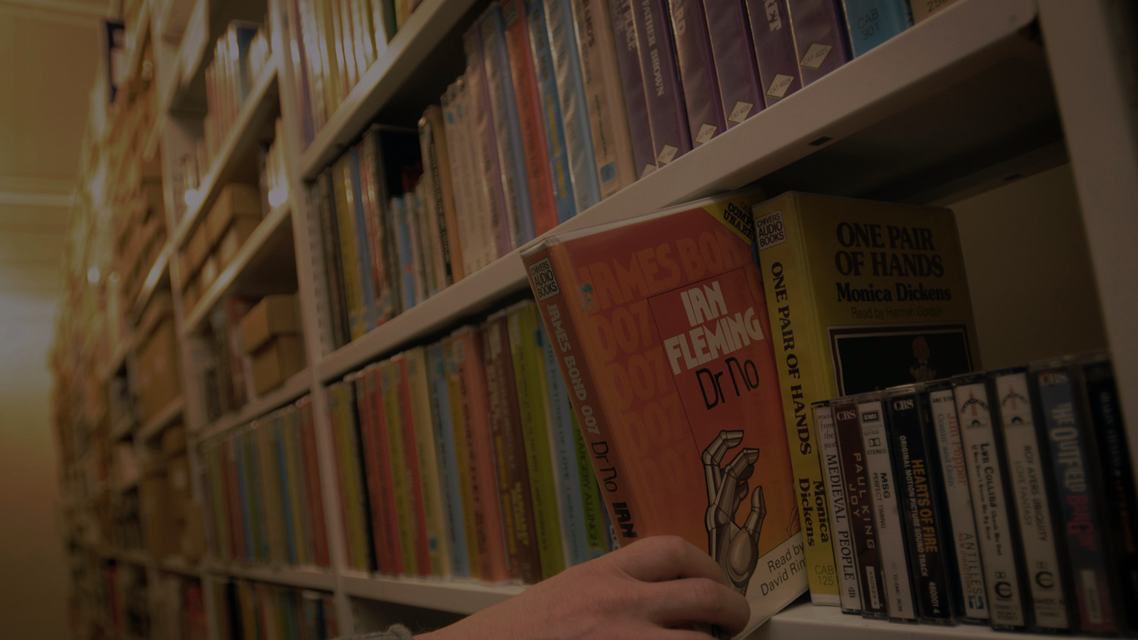
Modelling Data
Relationships between digital files, physical items and descriptive records can be complex
For an institution with multiple content types, understanding these relationships and finding commonalities between them is important
By modelling how files, descriptions and physical items interrelate across various types of media, a standard series of metadata profiles can be created
In doing this, digital content can be processed more easily by a preservation system and understood more simply by an access solution

Slide 9
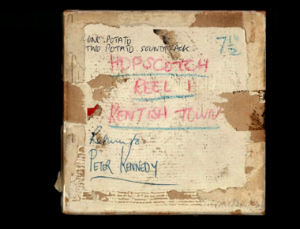
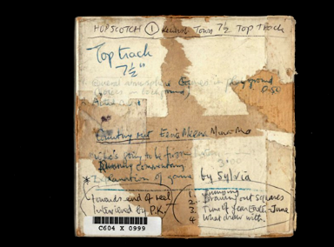
Physical
‘Logical’
‘Logical’
Tape 1, Side 1
= File 1
Tape 2, Side 1
= File 3
= File 2
Tape 1, Side 2
= File 4
Tape 2, Side 2

Slide 10
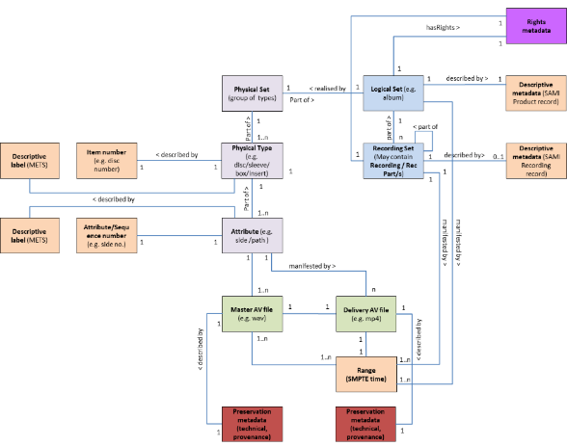

Slide 11
METS for Audio
METS provides a suitable framework for the description of complex audio objects
Enables recording of the physical structure of a resource (e.g. a tape and its sides), the logical structure (the recorded content), the files that comprise a resource and the relationships between them
Supports SMPTE timecode to define ranges within audio files
Allows insertion of preservation-level metadata in native schemas

Slide 12
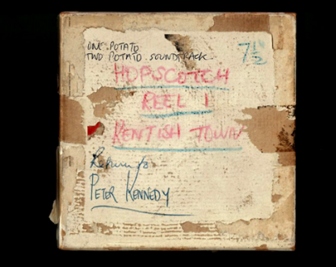
<mets:structMap TYPE="LOGICAL">
<mets:div ID="log0" TYPE="Work"
CONTENTIDS="ark:/81055/vdc_100059107815.0x000002"
DMDID="dmd0" ADMID="amd1-rights1">
</mets:div>
<mets:div ID="log1" TYPE="Recording"
CONTENTIDS="ark:/81055/vdc_100059107815.0x000006"
DMDID="dmd1">
</mets:structMap>

Slide 13
<mets:structMap TYPE="PHYSICAL">
<mets:div ID="phys0" TYPE="PhysicalResource"
CONTENTIDS="ark:/81055/vdc_100059107815.0x000001"
ORDER="1">
<mets:div ID="phys1" TYPE="Tape"
CONTENTIDS="ark:/81055/vdc_100059107815.0x000003" ORDER="1"
ORDERLABEL="Tape 1">
<mets:div ID="phys2" TYPE="Side"
CONTENTIDS="ark:/81055/vdc_100059107815.0x000004" ORDER="1"
ORDERLABEL="Tape 1 Side 1">
<mets:fptr FILEID="file1" />
</mets:div>
<mets:div ID="phys3" TYPE="Side"
CONTENTIDS="ark:/81055/vdc_100059107815.0x000005" ORDER="2"
ORDERLABEL="Tape 1 Side 2">
<mets:fptr FILEID="file2" />
</mets:div>
</mets:div>
</mets:div>
</mets:structMap>

Slide 14
<mets:div ID="phys0" TYPE="PhysicalResource"
CONTENTIDS="ark:/81055/vdc_100059107815.0x000001"
ORDER="1">
<mets:div ID="phys1" TYPE="Tape"
CONTENTIDS="ark:/81055/vdc_100059107815.0x000003" ORDER="1"
ORDERLABEL="Tape 1">
<mets:div ID="phys2" TYPE="Side" CONTENTIDS="ark:/81055/vdc_100059107815.0x000004" ORDER="1"
ORDERLABEL="Tape 1 Side 1">
<mets:fptr FILEID="file1" />
<mets:div ID="phys4" ORDER="1" TYPE="Recorded Area"
CONTENTIDS="ark:/81055/vdc_100059107815.0x000007">
<mets:fptr>
<mets:area FILEID="file1" BETYPE="SMPTE-25"
BEGIN="00:00:00:00" END="00:31:49:23" />
</mets:fptr>
</mets:div>

Slide 15
<mets:smLinkGrp>
<mets:smLocatorLink xlink:href="#log0" xlink:label="logentity"
xlink:type="locator" />
<mets:smLocatorLink xlink:href="#phys0" xlink:label="physentity"
xlink:type="locator" />
<mets:smArcLink ARCTYPE="logicalphysical"
xlink:from="logentity" xlink:to="physentity" xlink:type="arc" />
</mets:smLinkGrp>
<mets:smLinkGrp>
<mets:smLocatorLink xlink:href="#log1" xlink:label="logentity"
xlink:type="locator" />
<mets:smLocatorLink xlink:href="#phys4" xlink:label="physentityphys4"
xlink:type="locator" />
<mets:smLocatorLink xlink:href="#phys5" xlink:label="physentityphys5"
xlink:type="locator" />
<mets:smArcLink ARCTYPE="logicalphysical"
xlink:from="logentity" xlink:to="physentity-phys4" xlink:type="arc" />
<mets:smArcLink ARCTYPE="logicalphysical"
xlink:from="logentity" xlink:to="physentity-phys5" xlink:type="arc" />
</mets:smLinkGrp>
</mets:structLink>

Slide 17
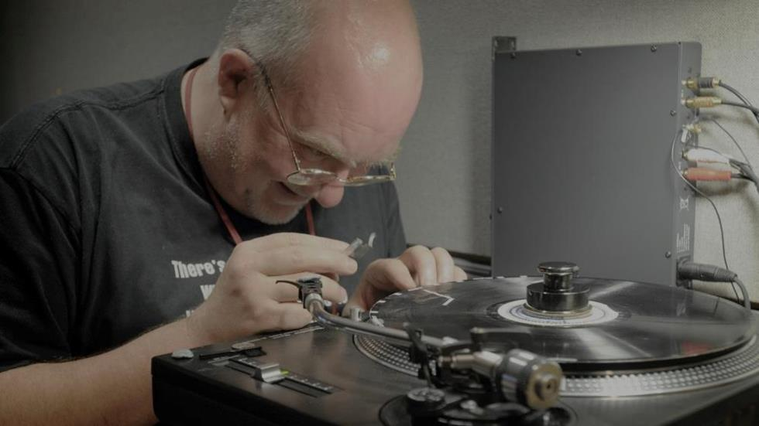
A SIP Tool for Audio
Manually creating metadata of the type and complexity described would be impractical and prone to error. A tool is needed.
Enable engineers to record information on the digitisation process and the physical structure of a resource
Enable cataloguers to record information on the logical structure of a resource
Web-based, enabling simultaneous users from around the UK
Validate files and create standard information packages

Slide 18
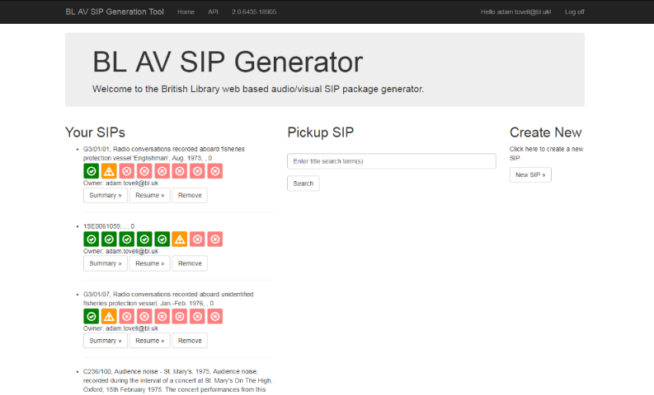

Slide 19
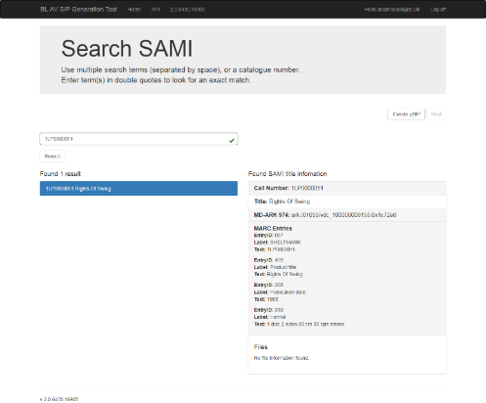

Slide 20
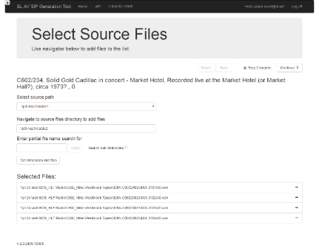

Slide 21
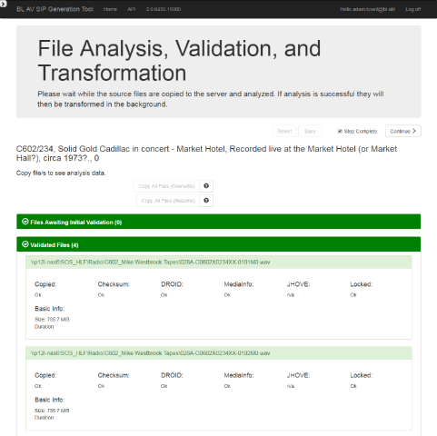

Slide 22
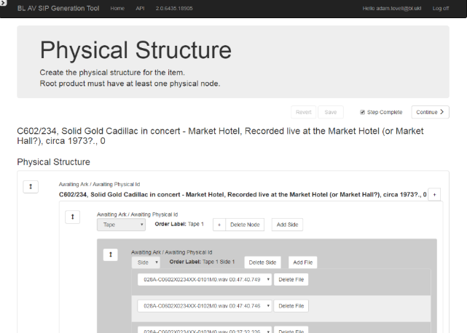

Slide 23
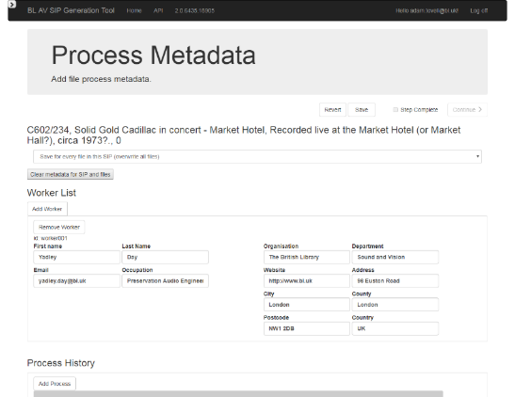

Slide 24
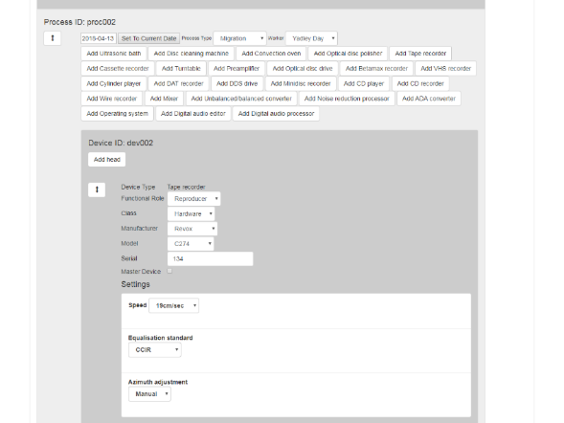

Slide 25
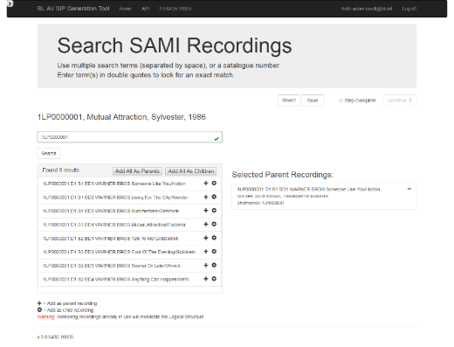

Slide 26
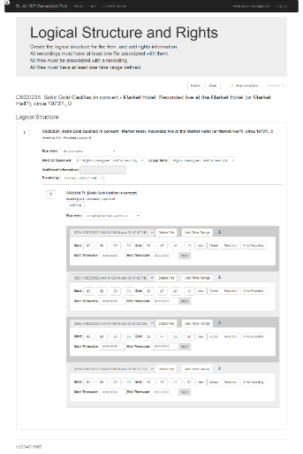

Slide 27
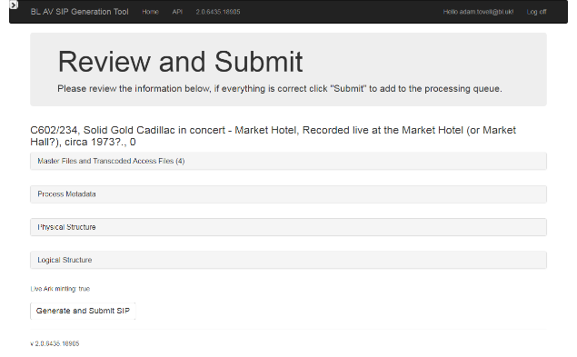

Slide 28
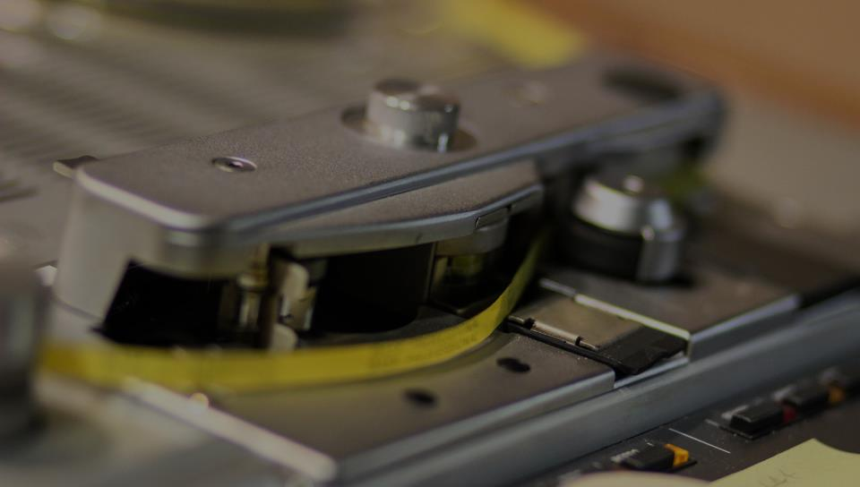
Enabling Access: IIIF
Many of the world’s digital resources are siloed, with access restricted to locally built applications. One institution’s delivery system is not compatible with another’s
Institutions have recognised the need to deliver sequences of files (e.g. digital images of scanned books) over the web, alongside ‘presentation-based’ (i.e. structural) metadata and descriptive metadata, in a standardised way.
As an interoperable technology for the delivery of digital content, IIIF, like METS, is attractive to those with large-scale digital collections of various media types.

Slide 29
Enabling Access: IIIF
A IIIF manifest describes a digital item as a sequence of ‘canvases’. A canvas is a virtual container for content; an empty box.
Content is ‘painted’ onto each canvas, in a sequence. Each canvas is given some descriptive metadata.
Through a IIIF-compliant viewer this approach allows the user to navigate a digital resource in a similar way as they would the original, physical item, page by page, and to understand the resource they are accessing.

Slide 30
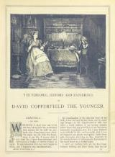
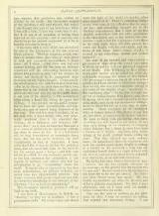

Slide 31
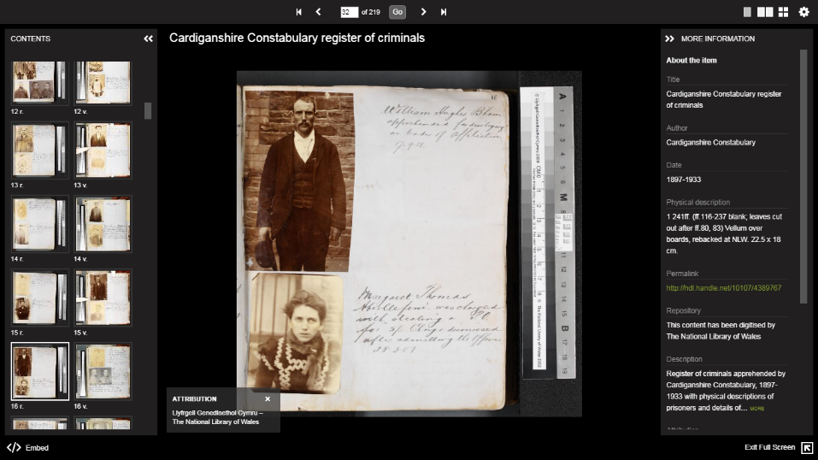

Slide 32
Enabling Access: IIIF
‘Ranges’ define a region of a canvas (e.g. a short article occurring within a page) or multiple regions of more than one canvas (e.g. a chapter spanning several pages). These ranges are defined by coordinate values for each digital image
By using range information, parts of content can be delivered to the user, e.g.an article or a chapter of a book
IIIF can be extended to support audio collections

Slide 33
IIIF for AV
By representing the physical and logical elements of a resource, IIIF can represent complex audio collections
A new version of the IIIF Presentation API is being developed to enable access to audio in a standardised way
The Universal Viewer is being developed to support this new framework
Metadata captured at the preservation stage can be transformed to IIIF and used to deliver content without extra steps

Slide 34


Slide 35
00:00:00.00
00:05:00.00
00:10:00.00
00:15:00.00
00:20:00.00
00:25:00.00
00:30:00.00
00:35:00.00
00:40:00.00
00:45:00.00
00:50:00.00
00:55:00.00
01:00:00.00
Manifest
File 1
c1#t=0,1800
File 2
c1#t=1800,3600
00:00:00.00
00:05:00.00
00:10:00.00
00:15:00.00
00:20:00.00
00:25:00.00
00:30:00.00
00:35:00.00
00:40:00.00
00:45:00.00
00:50:00.00
00:55:00.00
01:00:00.00

Slide 36
00:00:00.00
00:05:00.00
00:10:00.00
00:15:00.00
00:20:00.00
00:25:00.00
00:30:00.00
00:35:00.00
00:40:00.00
00:45:00.00
00:50:00.00
00:55:00.00
01:00:00.00
Range 1
c1#t=0,2100
Range 2
c1#t=2100,3000
Range 3
c1#t=3000,3600
Manifest
File 1
c1#t=0,1800
File 2
c1#t=1800,3600
00:00:00.00
00:05:00.00
00:10:00.00
00:15:00.00
00:20:00.00
00:25:00.00
00:30:00.00
00:35:00.00
00:40:00.00
00:45:00.00
00:50:00.00
00:55:00.00
01:00:00.00

Slide 37
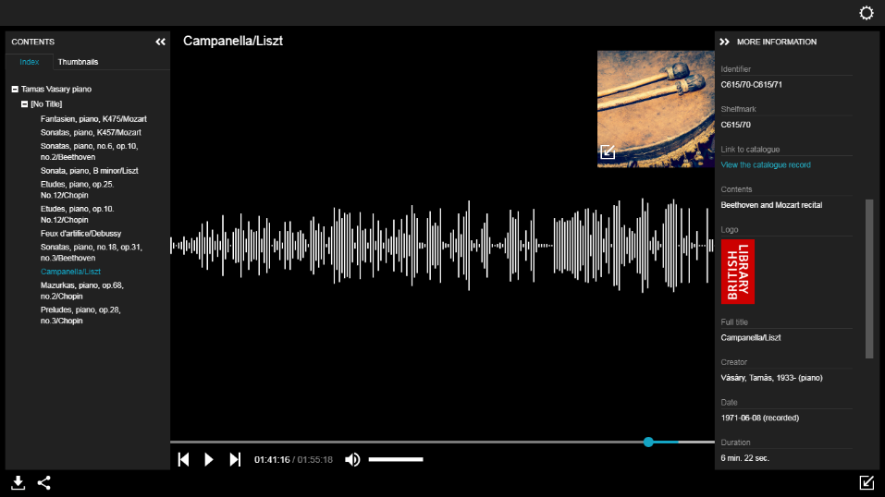

Slide 38
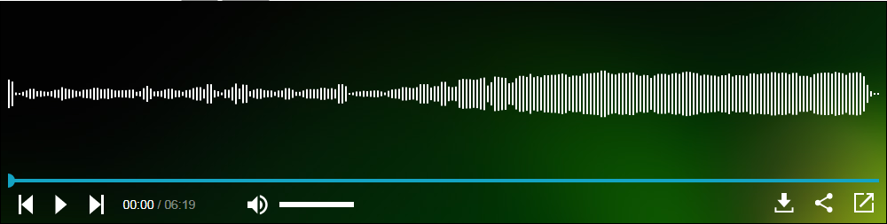

Slide 39
Thank you

